Slide 1
Strongly Connected Components
Every pair of vertices are reachable from each other
Graph G is strongly connected if, for every u and v in V, there is some path from u to v and some path from v to u.
Strongly Connected
Not Strongly Connected
Data Structure and Algorithm

Slide 2
Example
a
{ a , c , g }
g
c
d
{ f , d , e , b }
e
f
b
Data Structure and Algorithm

Slide 3
Finding Strongly Connected Components
Input: A directed graph G = (V,E)
Output: a partition of V into disjoint sets so that each set defines a strongly connected component of G
Data Structure and Algorithm

Slide 4
Algorithm
Strongly-Connected-Components(G)
call DFS(G) to compute finishing times f[u] for each vertex u. Cost: O(E+V)
compute G^{T} Cost: O(E+V)
call DFS(G^{T}), but in the main loop of DFS, consider the vertices in order of decreasing f[u] Cost: O(E+V)
output the vertices of each tree in the depth-first forest of step 3 as a separate strongly connected component.
The graph G^{T} is the transpose of G, which is visualized by reversing the arrows on the digraph.
Cost: O(E+V)
Data Structure and Algorithm

Slide 5
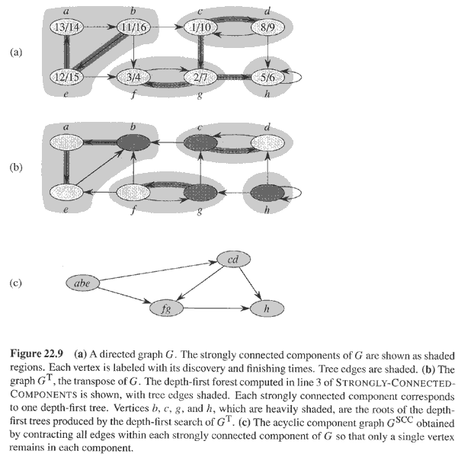
Example
Data Structure and Algorithm

